Slide 1
DRUGS AND HUMAN EYE: GLAUCOMA
BY
SHAEMA M. ALI

Slide 2
The eye
Coats of the eyeball
The eyeball consist of three coats
1- the fibrous coat
2- the vascular pigmented coat
3- the nervous coat

Slide 3
Fibrous coat
The fibrous coat is made up of a posterior opaque part, the sclera, and an anterior transparent part, the cornea.

Slide 4
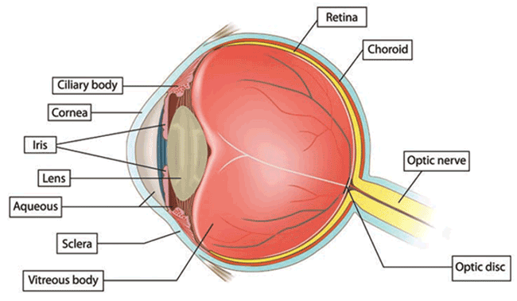

Slide 5
Posteriorly, the sclera is pierced by the optic nerve and is fused with the dural sheath of that nerve in an area called lamina cribrosa at the optic disc.
It is relatively week area and can be made to bulge into the eyeball by a rise of cerebrospinal fluid pressure in the subarachinoid space

Slide 7
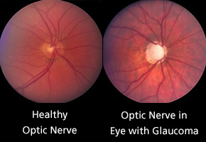
If the IOP rises, the lamina cribrosa will bulge outward, producing a cupped disc as seen through the opthalmoscope.

Slide 8
Vascular pigmented coat
The vascular pigmented coat consists from behind forward of the coroid, the ciliary body and the iris.

Slide 9
The choroid is composed of an outer pigmented layer and an inner highly vascular layer.

Slide 10
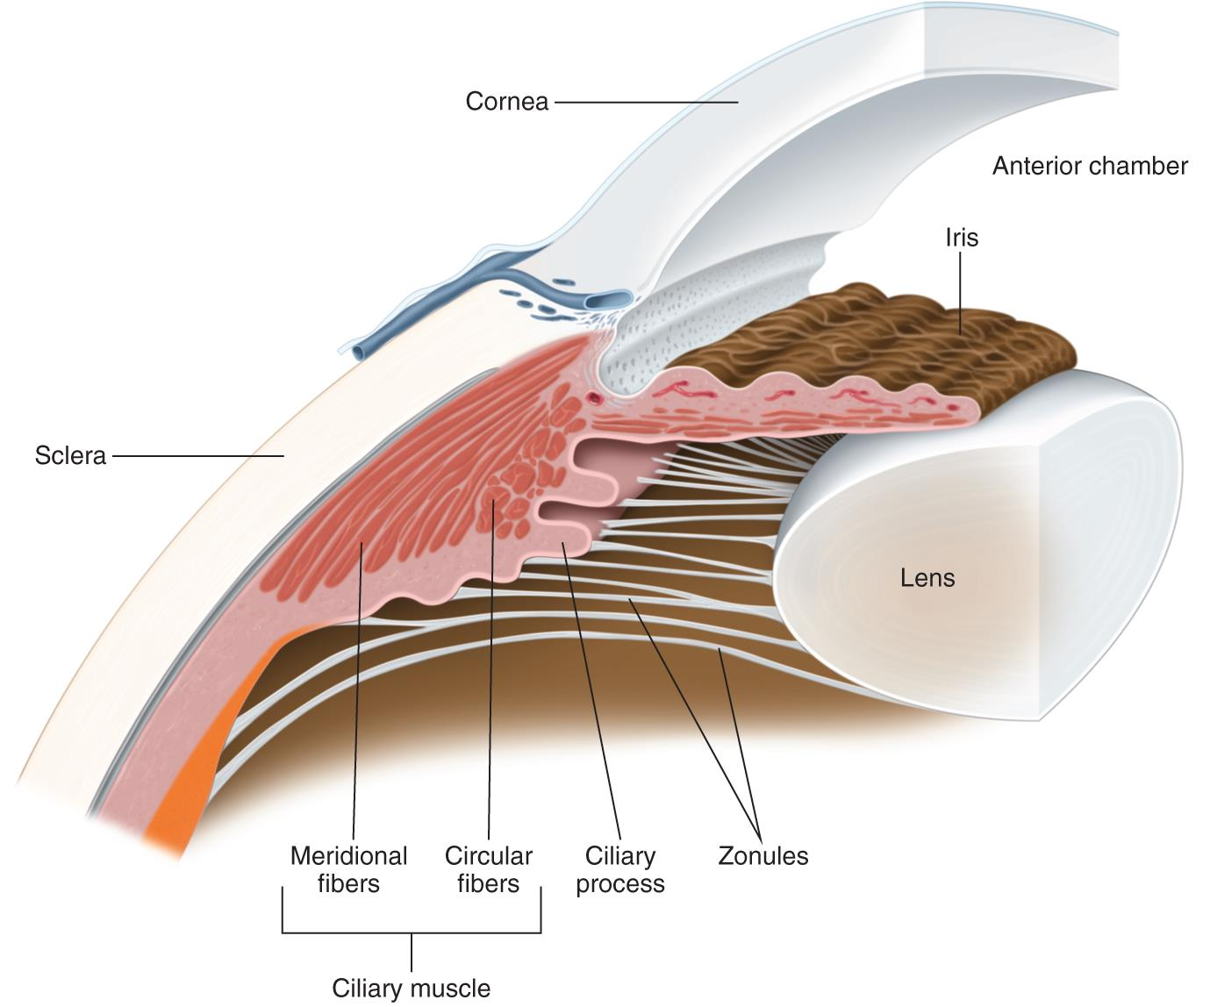
The ciliary body composed of ciliary processes
( secretion of aqueous humor) and ciliary muscles
( contraction of these muscles helps in accomodation for near vision).

Slide 11
The iris is a thin contractile pigmented diaphram with a central aperture, the pupil
It is suspended in the aqueous humor between the cornea and the lens
It divides the space between the cornea and the lens into an anterior and a posterior chamber

Slide 13
The muscle fibers of the iris are involuntary and consist of circular( parasympathetic innervation; miosis) and radiating fibers (sympathetic innervation; mydriasis).

Slide 15
Nervous coat: the retina
The retina consist of an outer pigmented layer and an inner nerveus layer

Slide 16
Contents of the eyeball
-lens biconvex body situated behind the iris and in front of the vitreous body
It attached to the ciliary processes by the suspensory ligament.
-Fluid system of the eye- Introcular fluid
The eye is filled with intraocular fluid which maintain sufficient pressure in the eyeball to keep it distended.

Slide 17
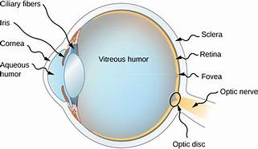
This fluid can be divided into two portions
Aqueous humor, which lies in front of the lens and vitreous humor , which is between the posterior surface of the lens and the retina.

Slide 18
Formation and outflow of aqueous humor
The aqueous humor is a clear fluid that fills the anterior and posterior chambers of the eyeball
It is a secretion or transudate from the ciliary processes, from which it enters the posterior chamber.

Slide 19
It then flows into the anterior chamber through the pupil and is drained away through the spaces at the iridocorneal angle into the canal of schlemm.

Slide 20
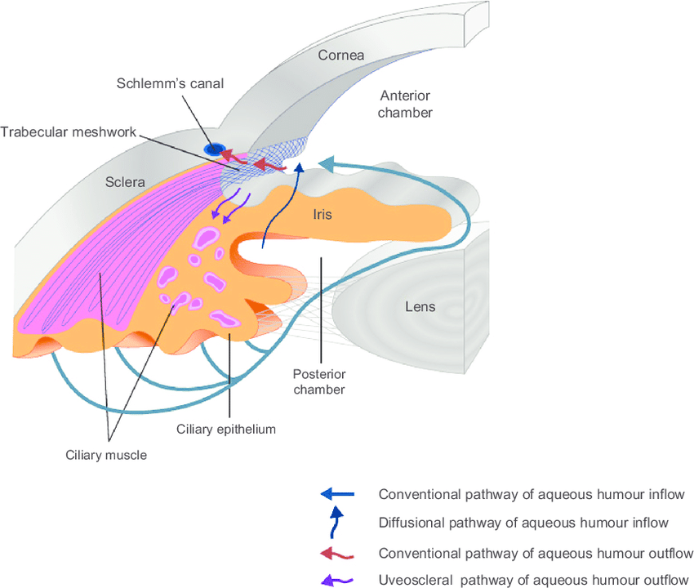

Slide 21
Obstruction to the draining of the aqueous humor results in a rise in IOP, called glucoma.
This can produce degenerative changes in the retina, with consequent blindness.

Slide 22
The disease is usually classified according to the manner in which aqueous humor outflow is impaired.
Primary open-angle glucoma
Primary angle-closure glucoma

Slide 23
Primary open-angle glucoma (POAG)
POAG is associated with a relative obstruction to aqueous outflow through the trabecular meshwork and is a chronic progressive disease of insidious onset usually affecting both eyes.

Slide 24
Primary angle closure glucoma (PACG)
PACG is a condtition in which closure of the angle by the peripheral iris results in a reduction in aqueous outflow.
It occurs in predisposed eyes and is frequently unilateral.

Slide 25
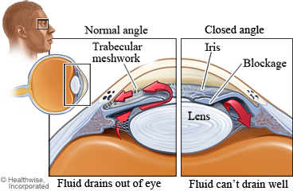

Slide 26
Etiology
The factors that determine the level of IOP are the rate of aqueous humor production and the resistance encountered in the outflow channels.
A fine balance between these is necessary to keep the pressure within the eye within the range of 16-21 mmHg.

Slide 27
Clinical manifestation
POAG, because of its insidious onset, is usually asymptomatic until it has caused a significant loss of visual field.
The earliest clinically significant field defect is scotoma, which is an area of depressed vision within the visual field.

Slide 28
Acute PACG is due to sudden closure of the angle and a severe elevation in IOP.
The symptoms include rapidly progressive visual impairment, periocular pain and congestion of the eye.
In severe cases nausea and vomiting may occur

Slide 29
Investigations
IOP is measured by tonometry
Scotoma can be detected by using perimetry
Gonioscopy is used to estimate the width of the chamber angle.
Cupping of the optic disc seen by ophthalmoscopy is used in both diagnosis and assessment of the efficacy of treatment.

Slide 31
Treatment
Primary angle glucoma
The prostaglandin analougues latanoprost and travoprost and the prostamide bimatoprost are indicated for first line use, as are the B blockers as these produce the greatest fall in IOP.

Slide 32
Carbonic anhydrase inhibitors and sympathomimetics which results in smaller fall in IOP, are considered second line drugs.

Slide 33
Pilocarpine is usually reserved for those patients not controlled by a combination of the drugs listed above.
Oral therapy with carbonic anhydrase inhibtors is usually reserved for use as the final stage of treatment in those complex glaucomas awaiting surgery.

Slide 34
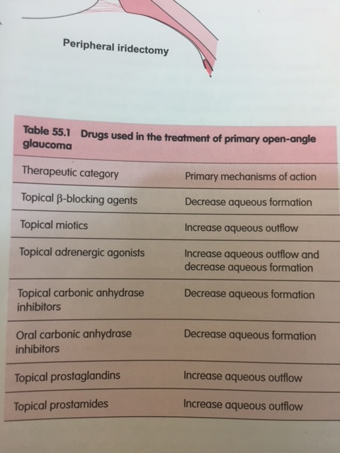

Slide 35
Primary angle closure glaucoma
Analgesics and antiemitcs are sometimes needed.
Intensive miotic therapy is usually ineffective and the IOP needs to be lowered by drugs that reduce aqueous humor production.

Slide 36
An intravenous loading dose of acetazolamide followed by oral treatment should allow the IOP to drop sufficiently to relieve iris ischemia and allow the sphincter to respond to pilocarpine therapy.

Slide 37
If this fails to decrease IOP, hyperosmotic agents ( glycerol and mannitol) may be required.
Once the IOP has been reduced medically, the condition is usually treated surgically.

Slide 38
Drug induced glaucoma
Several different drugs have the potential to cause the elevation of IOP which can occur via an open –angle mechanism or a closed angle mechanism.

Slide 39
Steroid-induced glaucoma is a form of open angle glaucoma that usually associated with topical steroid use.

Slide 40
medications that have a direct or secondary effect, either to stimulate sympathetic or inhibit parasympathetic activation causing pupillary dilation can precipitate acute ACG in patients with occludable angles.

Slide 41
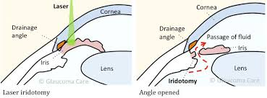
the most frequently performed surgical procedures create a fistula to act as a new route for aqueous outflow.
Laser trabeculoplasty
Laser ciliary ablation

Slide 42
These include topical anticholinergic or sympathomimetic dilating drops, tricyclic antidepressant, monoamine oxidase inhibitors, antihistamines, antiparkinsonian drugs, antipsychotic medication and antispasmolytic agents.

Slide 43
Note: sulfa containig medications may induce ACG by a different angle closure mechanism involving anterior rotation of the ciliary body.

